Slide 1
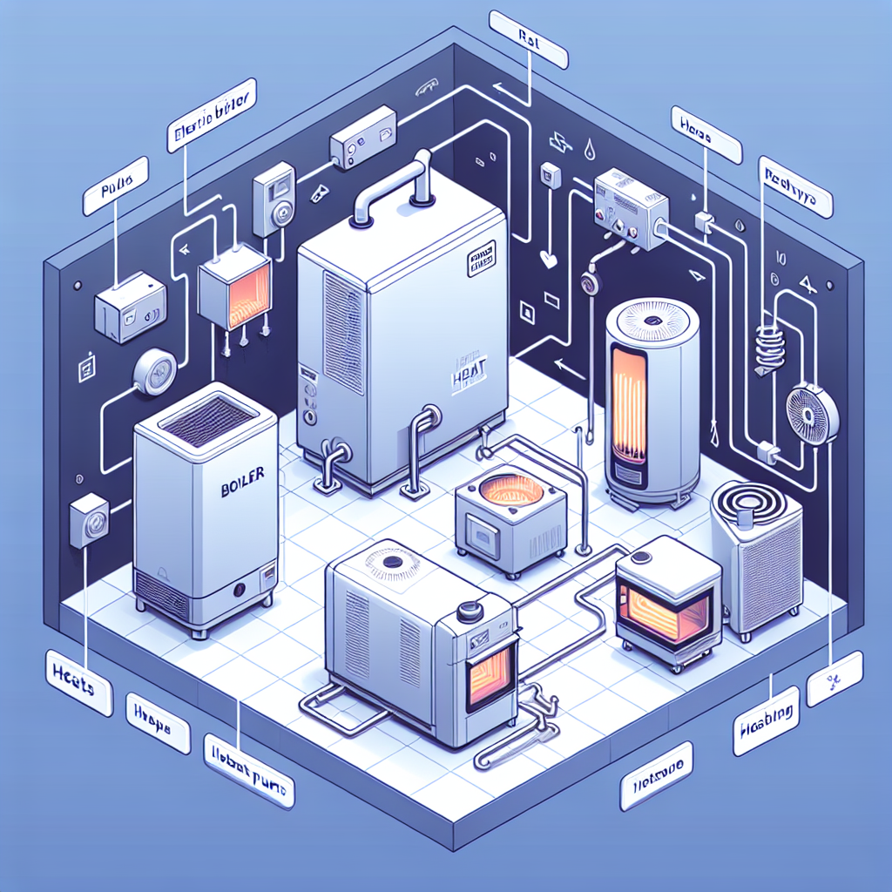
Process Electrification Roadmap
Baseline process heat mmbtu: 400000
2030 target: Electrify 60% of low/medium-temp heat; pilot one high-temp line; integrate 20k MMBtu/yr recovered waste heat
Equipment plan:
- 4 × 3 MW electric boilers (steam/hot water)
- 6 × 1.2 MW industrial heat pumps (COP 2.5–3.0) for low-temp processes
- 3 × electric IR/convective ovens (1.5–2 MW each) with zonal control
- Thermal storage (4 MWhth) for load shifting
Chart Area Placeholder
Phasing:
- 2024–2025: FEED studies, pilots on one dryer line, utility interconnection upgrades
- 2026–2027: Phase 1 install (2 boilers, 3 heat pumps), controls tuning
- 2028–2030: Phase 2 scale (remaining boilers/heat pumps, 3 IR ovens), waste-heat integration

